Slide 1


Memory-Based Rack Area Networking
Presented by: Cheng-Chun Tu
Advisor: Tzi-cker Chiueh
Stony Brook University & Industrial Technology Research Institute

Slide 2
Disaggregated Rack Architecture
Rack becomes a basic building block for cloud-scale data centers
CPU/memory/NICs/Disks embedded in self-contained server
  Disk pooling in a rack
  NIC/Disk/GPU pooling in a rack
  Memory/NIC/Disk pooling in a rack
Rack disaggregation
  Pooling of HW resources for global allocation and independent upgrade cycle for each resource type
Notes:
Hyperscale data centers increasingly use a rack rather than a machine as the basic building block.
A disaggregated rack architecture, in which a rack consists of a CPU/memory pool, a disk pool, and a network interface (NIC) pool, which are connected through a high-bandwidth and low-latency rack-area network.
Operationally, a major advantage of the disaggregated rack architecture is that it allows different system components, i.e. CPU, memory, disk and NIC, to be upgraded according to their own technology cycle.

Slide 3

Requirements
High-Speed Network
I/O Device Sharing
Direct I/O Access from VM
High Availability
Compatible with existing technologies
Notes:
The enabling technology or the requirements for disaggregated rack architecture includes
The key enabling technology for the disaggregated rack architecture is a High-speed rack-area networking that allows direct memory access
Today every server has an on-board PCIe bus
We propos a hybrid TOR switch that consists of both PCIe port and Ethernet ports

Slide 4



I/O Device Sharing
Reduce cost: One I/O device per rack rather than one per host
Maximize Utilization: Statistical multiplexing benefit
Power efficient: Intra-rack networking and device count
Reliability: Pool of devices available for backup
Non-Virtualized
Host
Non-Virtualized
Host
Virtualized Host
Virtualized Host
App1
App2
App1
App2
VM1
VM2
VM1
VM2
Operating Sys.
Operating Sys.
Hypervisor
Hypervisor
Switch
10Gb Ethernet / InfiniBand switch
Shared Devices:
GPU
SAS controller
Network Device
… other I/O devices
Co-processors
HDD/Flash-Based RAIDs
Ethernet NICs
Notes:
From the architectural standpoint, rack disaggregation decouples CPU/memory from I/O devices such as disk controllers and network interfaces,
and enables more efficient, flexible and robust I/O resource sharing.
The figure below shows the idea of I/O disaggregation,
We have non-virtualized host which runs the traditional OS, and virtualized host with multiple virtual machines
Each server extend their PCIe bus from its motherboard into a PCIe switch using PCIe expansion card.
Instead of using Ethernet switch, the PCIe switch becomes the new ToR switch, which requires to support intra-rack communication, the communication between servers
And the inter-rack communication, the communication out of the rack.
The benefits of I/O device disaggregation include
Reduce cost: because the I/O devices are shared in a rack so
And by leveraging the statistical multiplexing, each device can be full utilized, no device is idling
Power efficient: PCIe is more power-efficient because its transceiver is designed for short distance connectivity and thus is simpler and consumes less power.
Reliability:

Slide 5

PCI Express
PCI Express is a promising candidate
  Gen3 x 16 lane = 128Gbps with low latency (150ns per hop)
  New hybrid top-of-rack (TOR) switch consists of PCIe ports and Ethernet ports
Universal interface for I/O Devices
  Network , storage, graphic cards, etc.
  Native support for I/O device sharing
I/O Virtualization
  SR-IOV enables direct I/O device access from VM
  Multi-Root I/O Virtualization (MRIOV)

Slide 6

Challenges
Single Host (Single-Root) Model
  Not designed for interconnecting/sharing amount multiple hosts (Multi-Root)
Share I/O devices securely and efficiently
Support socket-based applications over PCIe
Direct I/O device access from guest OSes

Slide 7
Observations
PCIe: a packet-based network (TLP)
  But all about it is memory addresses
Basic I/O Device Access Model
  Device Probing
  Device-Specific Configuration
  DMA (Direct Memory Access)
  Interrupt (MSI, MSI-X)
Everything is through memory access!
  Thus, “Memory-Based” Rack Area Networking

Slide 8
Proposal: Marlin
Unify rack area network using PCIe
  Extend server’s internal PCIe bus to the TOR PCIe switch
  Provide efficient inter-host communication over PCIe
Enable clever ways of resource sharing
  Share network, storage device, and memory
Support for I/O Virtualization
  Reduce context switching overhead caused by interrupts
Global shared memory network
  Non-cache coherent, enable global communication through direct load/store operation

Slide 9
Introduction
PCIe Architecture, SR-IOV, MR-IOV, and NTB (Non-Transparent Bridge)

Slide 10
PCIe Single Root Architecture
Multi-CPU, one root complex hierarchies
  Single PCIe hierarchy
Single Address/ID Domain
  BIOS/System software probes topology
  Partition and allocate resources
Each device owns a range(s)of physical address
  BAR addresses, MSI-X, and device ID
  Strict hierarchical routing
CPU #n
CPU #n
CPU #n
Write Physical Address:
0x55,000
To Endpoint1
PCIe
Root Complex
Routing table BAR:
0x10000 – 0x90000
PCIe
Endpoint
PCIe TB
Switch
PCIe
Endpoint
Routing table BAR:
0x10000 – 0x60000
PCIe TB
Switch
PCIe TB
Switch
PCIe
Endpoint1
PCIe
Endpoint2
PCIe
Endpoint3
BAR0: 0x50000 - 0x60000
TB: Transparent Bridge
Notes:
So what is Single root?
The PCIe hierarchy in Today’s server is a single root architecture.
Multiple CPUs are connected to the root complex.
And the process of PCI enumeration starts probing from the root complex,
To all the devices on the board and assigned BAR addresses to each endpoints and device ID as well as routing information to to transparent bridges.
So this is a single address space domain, with each device owns some resources

Slide 11
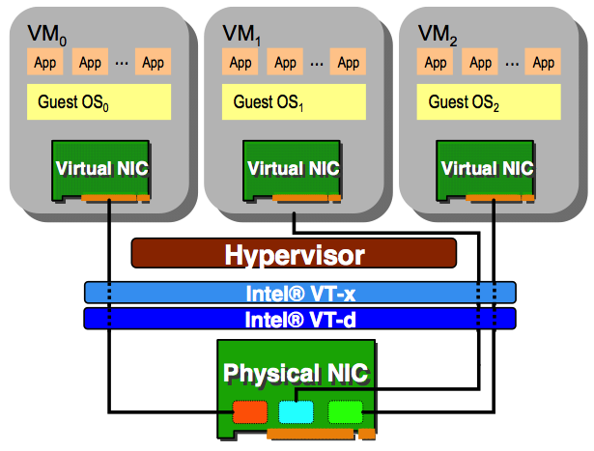
Single Host I/O Virtualization
Direct communication:
  Direct assigned to VMs
  Hypervisor bypassing
Physical Function (PF):
  Configure and manage the SR-IOV functionality
Virtual Function (VF):
  Lightweight PCIe function
  With resources necessary for data movement
Intel VT-x and VT-d
  CPU/Chipset support for VMs and devices
Host1 Host2 Host3
Can we extend virtual NICs to multiple hosts?
VF
VF
VF
Makes one device “look” like multiple devices
Figure: Intel® 82599 SR-IOV Driver Companion Guide
Notes:
IOV vritualizaion make one physical device look like many devices
The most common example is the network card in a physical machine running multiple VMs.
Without IOV, the hypervisor needs to have an software switch that copies receiving packet and transmitting packets to and from the physical NIC.
This greatly increases the CPU’s workload and decreases the overall IO performance.
With IO virtualization, multiple virtual devices (we called VF, virtual function or Virtual NIC) can be configured in one device.
And directly pass through to the VM.
So each VM works as it has the network interface card and the packet transmission and reception no longer involve hypervisor.
The software model of SRIOV includes a PF and multiple VF
The virtual NIC or virtual function is a light weight PCIe function with resource for data plane.
However, today’ IOV is restricted in a single host or single root. The other hosts, or other VM on other hosts can not share the resources.
===
Single root IOV pushes much of the SW overhead into the IO adapter
Leads to improve performance for guest OS applications
http://www.istockanalyst.com/finance/story/6239562/intel-intc-facebook-fb-collaborating-on-new-rack-scale-server-architecture

Slide 12
Multi-Root Architecture
Host Domains
Host1 Host2 Host3
Interconnect multiple hosts
  No coordination between RCs
  One domain for each root complex → Virtual Hierarchy (VH)
  Endpoint4 is shared
Multi-Root Aware (MRA) switch/endpoints
  New switch silicon
  New endpoint silicon
  Management model
  Lots of HW upgrades
  Not/rare available
CPU #n
CPU #n
CPU #n
CPU #n
CPU #n
CPU #n
CPU #n
CPU #n
CPU #n
MR PCIM
PCIe Root Complex1
PCIe Root Complex2
PCIe Root Complex3
PCIe
Endpoint1
PCIe
Endpoint2
How do we enable MR-IOV without relying
on Virtual Hierarchy?
PCIe MRA Switch1
PCIe MR
Endpoint3
PCIe TB
Switch2
PCIe TB
Switch3
Link
VH1
VH2
VH3
PCIe MR
Endpoint4
PCIe MR
Endpoint5
PCIe MR
Endpoint6
Shared by
VH1 and VH2
Shared Device Domains
Notes:
As for multi root, multiple host domains can be connected together using PCIe cable with an enhanced PCIe switch in the middle , or the MR-capable PCIe switch
Each single host domain still has its local endpoint and address space, and it is also allowed to access the shared device pool under the enhanced PCIe switch.
So the main task of the enhanced pcie switch is to isolate each host domain’s address space and provide mechanism for
CPUs in different domains to access the shared device or the other way around.
Obviously, this is much harder than SRIOV, because it require not only the enhanced PCIe switch, but all external IO devices need to support MR IOV.
It requires new switch silicon, endpoints and management model.
Our solution is to use NTB to isolation between host domains as well as provide data communication.
== End ==
VH (Virtual Hierarchy)
map the virtual functions to the assigned host domain, and route the PCIe transcation to the destionation.

Slide 13

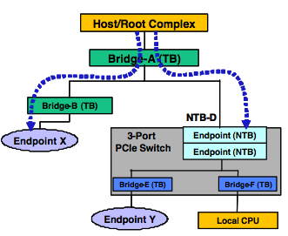

Non-Transparent Bridge (NTB)
Isolation of two hosts’ PCIe domains
  Two-side device
  Host stops PCI enumeration
  at NTB-D.
  Yet allow status and data exchange
Translation between domains
  PCI device ID:
  Querying the ID lookup table (LUT)
  Address:
  From primary side and secondary side
Example:
  External NTB device
  CPU-integrated: Intel Xeon E5
Host A
[1:0.1]
[2:0.2]
Host B
Figure: Multi-Host System and Intelligent I/O Design with PCI Express
Notes:
NTB is a PCI-SIG standard which defines is a device having sides back-to-back that isolates two PCIe domain.
As shown in the right figure, we connect two servers, A and B, using NTB.
Host A on top initially do device enumeration, found endpoint X and stops enumerating at NTB,
While host B below detects endpoints Y, and stops at the lower side of the NTB.
So both the host A and host B has their independent address spaces, and
NTB provide 2 translation mechanisms: The ID translation and The address translation
The ID translation allows a device in a domain to be accessed by the other domain by looking up an ID translation table called “LUT” (look up table)
For example, endpoint X could be assigned ID 1:0.1, and the host B can access it using 2:0.0 by looking up the translation table.
The address translation allows the PCIe memory read /write to cross the NTB and reach the other address domain.
===
Multi-Host System and Intelligent I/O Design with PCI Express
The non-transparent bridging (NTB) function enables isolation of two hosts or memory domains yet allows status and data exchange between the two hosts or sub-systems.

Slide 14
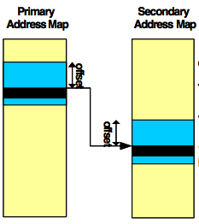
NTB Address Translation
NTB address translation:
  <the primary side to the secondary side>
Configuration:
  addrA at primary side’s BAR window to addrB at the secondary side
Example:
  addrA = 0x8000 at BAR4 from HostA
  addrB = 0x10000 at HostB’s DRAM
One-way Translation:
  HostA read/write at addrA (0x8000) == read/write addrB
  HostB read/write at addrB has nothing to do with addrA in HostA
Figure: Multi-Host System and Intelligent I/O Design with PCI Express
Notes:
Let’s take an example of address translation.
We have hostA on the left side and host B on the right side.
If host A want to access the memory region of host B,
We first open an address window on address 0x8000 at host A and set up the translation register to target the address 0x10000 at the hostB.
By this configuration, when hostA’s CPU or device writes or read address 0x8000,
the PCIe packet containing this address will be translated to address 0x10000 in hostB’s domain and write to this memory location.

Slide 15
I/O Device Sharing
Sharing SR-IOV NIC securely and efficiently [ISCA’13]

Slide 16
Global Physical Address Space
Physical Address Space of MH
Leverage unused physical address space, map each host to MH
Each machine could write to another machine’s entire physical address space
2⁴⁸ = 256T
MMIO
NTB
IOMMU
Physical Memory
256G
CH n
NTB
MH writes
to 200G
IOMMU
MMIO
192G
VF1
Physical Memory
NTB
VF2
128G
CH2
:
IOMMU
VFn
MMIO
Global
> 64G
CSR/MMIO
MMIO
CH writes
To 100G
Physical Memory
Physical Memory
MH: Management Host
CH: Compute Host
64G
Local
< 64G
MH
CH1
0
Notes:
Of course, this accessibility is carefully regulated through various mapping tables, specifically, EPT, IOMMU and device ID table.

Slide 17
Address Translations
CPUs and devices could access remote host’s memory address space directly.
hpa
-> host physical addr.
-> host virtual addr.
-> guest virtual addr.
-> guest physical addr.
-> device virtual addr.
hva
gva
5. MH’s CPU
Write 200G
gpa
6. MH’s device
(P2P)
dva
CPU
DEV
4. CH VM’s CPU
hva
dva
CPU
CH’s CPU
CH’s device
PT
IOMMU
gva
hpa
hpa
CPU
DEV
GPT
NTB
NTB
hva
dva
gpa
dva
dva
PT
IOMMU
EPT
IOMMU
IOMMU
CH’s Physical Address Space

Slide 18
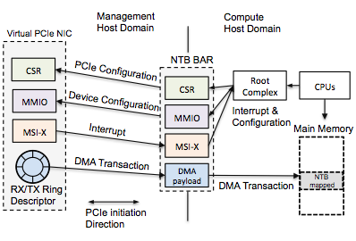
Virtual NIC Configuration
4 Operations: CSR, device configuration, Interrupt, and DMA
Observation: everything is memory read/write!
Sharing: a virtual NIC is backed by a VF of an SRIOV NIC and redirect memory access cross PCIe domain
Native I/O device sharing is realized by
memory address redirection!

Slide 19
System Components
Compute Host (CH)
Management Host (MH)

Slide 20

Parallel and Scalable Storage Sharing
Proxy-Based Non-SRIOV SAS controller
  Each CH has a pseudo SCSI driver to redirect cmd to MH
  MH has a proxy driver receiving the requests, and enable SAS controller to direct DMA and interrupt to CHs
Two direct accesses out of 4 Operations:
  Redirect CSR and device configuration: involve MH’s CPU.
  DMA and Interrupts are directly forwarded to the CHs.
Bottleneck!
PCIe
Management
Host
Management
Host
Ethernet
Compute Host1
Compute Host2
SCSI cmd
iSCSI Target
TCP(iSCSI)
iSCSI initiator
Pseudo SAS driver
Proxy-Based SAS driver
SAS driver
TCP(data)
DMA and Interrupt
DMA and Interrupt
SAS Device
SAS Device
iSCSI
Marlin
See also: A3CUBE’s Ronnie Express

Slide 21



Security Guarantees: 4 cases
MH
CH1
CH2
VM1
VM2
VM1
VM2
Main Memory
VF
VF
VF
VF
PF
VMM
VMM
PCIe Switch Fabric
PF
VF1
VF2
VF3
VF4
Device assignment
SR – IOV Device
Unauthorized Access
VF1 is assigned to VM1 in CH1, but it can screw multiple memory areas.

Slide 22
Security Guarantees
Intra-Host
  A VF assigned to a VM can only access to memory assigned to the VM. Accessing other VMs is blocked host’s IOMMU
Inter-Host:
  A VF can only access the CH it belongs to. Accessing other hosts is blocked by other CH’s IOMMU
Inter-VF / inter-device
  A VF can not write to other VF’s registers.
  Isolate by MH’s IOMMU.
Compromised CH
  Not allow to touch other CH’s memory nor MH
  Blocked by other CH/MH’s IOMMU
Global address space for resource sharing is secure and efficient!

Slide 23
Inter-Host Communication
Topic: Marlin Top-of-Rack Switch, Ether Over PCIe (EOP)
CMMC (Cross Machine Memory Copying), High Availability

Slide 24
Marlin TOR switch
PCIe
Ethernet
Each host has 2 interfaces: inter-rack and inter-host
Inter-Rack traffic goes through Ethernet SRIOV device
Intra-Rack (Inter-Host) traffic goes through PCIe

Slide 25
Inter-Host Communication
HRDMA: Hardware-based Remote DMA
  Move data from one host’s memory to another host’s memory using the DMA engine in each CH
How to support socket-based application?
  Ethernet over PCIe (EOP)
  An pseudo Ethernet interface for socket applications
How to have app-to-app zero copying?
  Cross-Machine Memory Copying (CMMC)
  From the address space of one process on one host to the address space of another process on another host
Notes:
Intel quickdata dma

Slide 26
Cross Machine Memory Copying
Device Support RDMA
  Several DMA transactions, protocol overhead, and device-specific optimization.
Native PCIe RDMA, Cut-Through forwarding
CPU load/store operations (non-coherent)
InfiniBand/Ethernet RDMA
Payload
RX buffer
DMA to internal
device memory
DMA to receiver buffer
IB/Ethernet
fragmentation/encapsulation,
DMA to the IB link
PCIe
PCIe
Payload
RX buffer
DMA engine
(ex: Intel Xeon E5 DMA)

Slide 27
Inter-Host Inter-Processor INT
I/O Device generates interrupt
Inter-host Inter-Processor Interrupt
  Do not use NTB’s doorbell due to high latency
  CH1 issues 1 memory write, translated to become an MSI at CH2 (total: 1.2 us latency)
Send packet
IRQ handler
Interrupt
CH1
CH2
InfiniBand/Ethernet
Memory Write
Interrupt
Data / MSI
NTB
IRQ handler
CH1 Addr: 96G+0xfee00000
PCIe Fabric
CH2 Addr: 0xfee00000

Slide 28
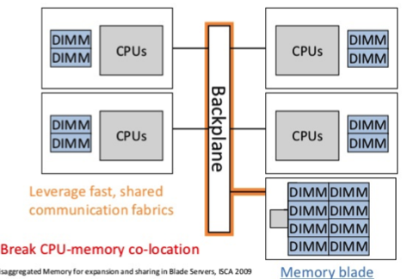
Shared Memory Abstraction
Two machines share one global memory
  Non-Cache-Coherent, no LOCK# due to PCIe
  Implement software lock using Lamport’s Bakery Algo.
Dedicated memory to a host
PCIe fabric
Compute
Hosts
Remote
Memory
Blade
Reference: Disaggregated Memory for Expansion and Sharing in Blade Servers [ISCA’09]

Slide 29
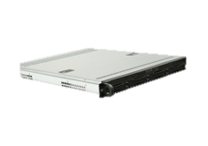

Control Plane Failover
…
…
  MMH (Master) connected to the upstream port of VS1, and
  BMH (Backup) connected to the upstream port of VS2.
Master MH
Virtual Switch 1
upstream
Slave MH
Ethernet
VS2
…
…
  When MMH fails, VS2 takes over all the downstream ports
  by issuing port re-assignment (does not affect peer-to-peer routing states).
Master MH
…
Virtual Switch 2
VS1
TB
Slave MH
Ethernet
…

Slide 30
Multi-Path Configuration
Physical Address Space of MH
Equip two NTBs per host
  Prim-NTB and Back-NTB
  Two PCIe links to TOR switch
Map the backup path to backup address space
Detect failure by PCIe AER
  Require both MH and CHs
Switch path by remap virtual-to-physical address
2⁴⁸
MMIO
Back-NTB
Backup Path
Physical Memory
1T+128G
CH1
Primary Path
192G
Prim-NTB
128G
MH writes to 200G goes through primary path
MH writes to 1T+200G goes through backup path
MMIO
Physical Memory
MH
0
Notes:
Of course, this accessibility is carefully regulated through various mapping tables, specifically, EPT, IOMMU and device ID table.

Slide 31
Direct Interrupt Delivery
Topic: Direct SRIOV Interrupt,
Direct virtual device interrupt , Direct timer Interrupt

Slide 32
DID: Motivation
4 operations: interrupt is not direct!
  Unnecessary VM exits
  Ex: 3 exits per Local APIC timer
Existing solutions:
  Focus on SRIOV and leverage shadow IDT (IBM ELI)
  Focus on PV, require guest kernel modification (IBM ELVIS)
  Hardware upgrade: Intel APIC-v or AMD VGIC
  DID direct delivers ALL interrupts without paravirtualization
Start handling the timer
Timer
set-up
Interrupt
Injection
Guest
(non-root mode)
Host
(root mode)
Interrupt due
To Timer expires
End-of-
Interrupt
Software Timer
Software Timer
Inject vINT

Slide 33
Direct Interrupt Delivery
Definition:
  An interrupt destined for a VM
  goes directly to VM without any
  software intervention.
  Directly reach VM’s IDT.
Disable external interrupt exiting (EIE) bit in VMCS
Challenges: mis-delivery problem
  Delivering interrupt to the unintended VM
  Routing: which core is the VM runs on?
  Scheduled: Is the VM currently de-scheduled or not?
  Signaling completion of interrupt to the controller (direct EOI)
Virtual Devices
VM
Virtual device
Local APIC timer
SRIOV device
Back-end
Drivers
core
VM
core
SRIOV
Hypervisor

Slide 34

Direct SRIOV Interrupt
VM1
VM1
VM2
1. VM Exit
core1
core1
2. KVM receives INT
3. Inject vINT
SRIOV
VF1
SRIOV
VF1
NMI
IOMMU
IOMMU
1. VM M is running.
2. Interrupt for VM M,
but VM M is de-scheduled.
Every external interrupt triggers VM exit, allowing KVM to inject virtual interrupt using emulated LAPIC
DID disables EIE (External Interrupt Exiting)
  Interrupt could directly reach VM’s IDT
How to force VM exit when disabling EIE? NMI

Slide 35
Virtual Device Interrupt
Assume device vector #: v
I/O thread
VM (v)
I/O thread
VM (v)
VM Exit
core
core
core
core
Tradition: send IPI and
kick off the VM, hypervisor inject virtual interrupt v
DID: send IPI directly
with vector v
Assume VM M has virtual device with vector #v
DID: Virtual device thread (back-end driver) issues IPI with vector #v to the CPU core running VM
The device’s handler in VM gets invoked directly
If VM M is de-scheduled, inject IPI-based virtual interrupt

Slide 36
Direct Timer Interrupt
Today:
  x86 timer is located in the per-core local APIC registers
  KVM virtualizes LAPIC timer to VM
    Software-emulated LAPIC.
  Drawback: high latency due to several VM exits per timer operation.
CPU1
CPU2
timer
LAPIC
LAPIC
IOMMU
External
interrupt
DID direct delivers timer to VMs:
  Disable the timer-related MSR trapping in VMCS bitmap.
  Timer interrupt is not routed through IOMMU so when VM M runs on core C, M exclusively uses C’s LAPIC timer
  Hypervisor revokes the timers when M is de-scheduled.

Slide 37
DID Summary
DID direct delivers all sources of interrupts
  SRIOV, Virtual Device, and Timer
  Enable direct End-Of-Interrupt (EOI)
  No guest kernel modification
  More time spent in guest mode
Guest
Host
Guest
SR-IOV
interrupt
Timer
interrupt
PV
interrupt
SR-IOV
interrupt
Host
EOI
EOI
EOI
EOI
time

Slide 38
Implementation & Evaluation

Slide 39

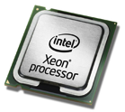

Prototype Implementation
CH:
Intel i7 3.4GHz /
Intel Xeon E5
8-core CPU
8 GB of memory
VM:
Pin 1 core, 2GB RAM
OS/hypervisor:
Fedora15 / KVM
Linux 2.6.38 / 3.6-rc4
Link: Gen2 x8 (32Gb)
NTB/Switch:
PLX8619
PLX8696
MH:
Supermicro E3 tower
8-core Intel Xeon 3.4GHz
8GB memory
NIC: Intel 82599

Slide 40
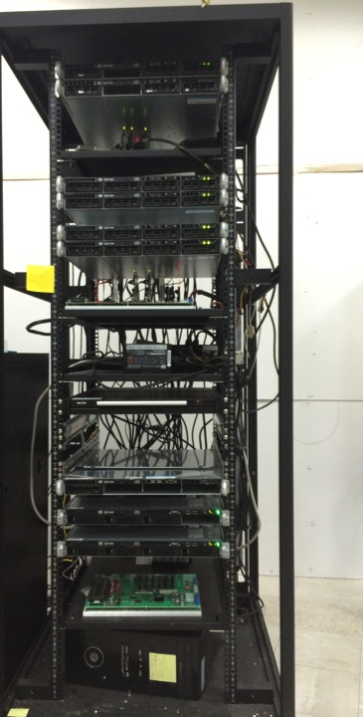
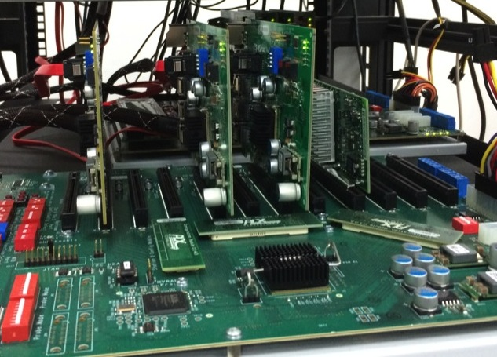
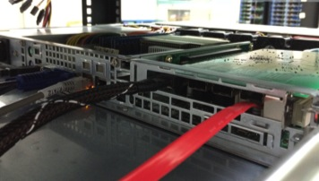
NTB PEX 8717
PLX Gen3 Test-bed
Intel 82599
48-lane 12-port PEX 8748
1U server behind
Intel NTB Servers

Slide 41

Software Architecture of CH
MSI-X

Slide 42
I/O Sharing Performance
Copying Overhead

Slide 43
Inter-Host Communication
TCP unaligned: Packet payload addresses are not 64B aligned
TCP aligned + copy: Allocate a buffer and copy the unaligned payload
TCP aligned: Packet payload addresses are 64B aligned
UDP aligned: Packet payload addresses are 64B aligned

Slide 44
Interrupt Invocation Latency
DID has 0.9us overhead
KVM latency is much higher due to 3 VM exits
Setup: VM runs cyclictest, measuring the latency between
hardware interrupt generated and user level handler is invoked.
experiment: highest priority, 1K interrupts / sec
KVM shows 14us due to 3 exits: external interrupt, program x2APIC (TMICT), and EOI per interrupt handling.

Slide 45
Memcached Benchmark
DID improves 18% TIG (Time In Guest)
DID improve x3 performance
TIG: % of time
CPU in guest mode
Set-up: twitter-like workload and measure the peak requests served per second (RPS) while maintaining 10ms latency
PV / PV-DID: Intra-host memecached client/sever
SRIOV/SRIOV-DID: Inter-host memecached client/sever
Notes:
emulate a twitter-like workload and measure the peak requests served per second (RPS) while maintaining 10ms latency for at least 95% of requests.

Slide 46
Discussion
Ethernet / InfiniBand
  Designed for longer distance, larger scale
  InfiniBand is limited source (only Mellanox and Intel)
QuickPath / HyperTransport
  Cache coherent inter-processor link
  Short distance, tightly integrated in a single system
NUMAlink / SCI (Scalable Coherent Interface)
  High-end shared memory supercomputer
PCIe is more power-efficient
  Transceiver is designed for short distance connectivity

Slide 47
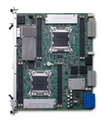
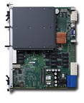

Contribution
We design, implement, and evaluate a PCIe-based rack area network
  PCIe-based global shared memory network using standard and commodity building blocks
  Secure I/O device sharing with native performance
  Hybrid TOR switch with inter-host communication
  High Availability control plane and data plane fail-over
  DID hypervisor: Low virtualization overhead
Marlin Platform
Processor Board
PCIe Switch Blade
I/O Device Pool

Slide 48
Other Works/Publications
SDN
  Peregrine: An All-Layer-2 Container Computer Network, CLOUD’12
  SIMPLE-fying Middlebox Policy Enforcement Using SDN, SIGCOMM’13
  In-Band Control for an Ethernet-Based Software-Defined Network, SYSTOR’14
Rack Area Networking
  Secure I/O Device Sharing among Virtual Machines on Multiple Host, ISCA’13
  Software-Defined Memory-Based Rack Area Networking, under submission to ANCS’14
  A Comprehensive Implementation of Direct Interrupt,
  under submission to ASPLOS’14

Slide 49


Thank You
Dislike? Like?
Question?

Slide 50
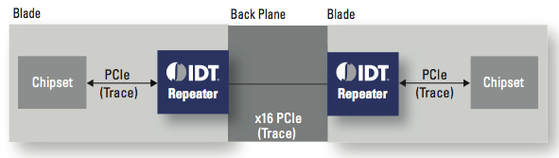
PCIe Practical Issues
Signal Integrity
  High speed signals can deteriorate to unacceptable levels
  Around 10 meters
Retimers, repeaters, redrivers

Slide 51
Requirements of NFV platform
Bare-metal hypervisor performance
  Especially I/O performance → DID hypervisor
Fast inter-VM or inter-network function channel
  PCIe fabric, global address space, HRDMA, device sharing
Enforce middlebox processing sequences
  Leverage the SDN controller and OpenFlow [SIMPLE-SIGCOMM’13]

Slide 52
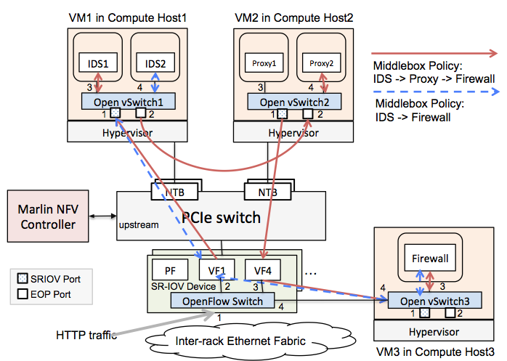




Future Work:
Software-Defined NFV Platform

Slide 53
Backup Materials

Slide 54
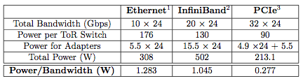
System-Level Related Work
Proprietary hardware
  PLX FabricExpress (2013)
A3Cube Ronniee Express (March 2014)

Slide 55
SDN and NFV
Software-Defined Network (SDN)
  Separate control and forwarding
  Centralized Controller
  Protocol to couple control and forwarding: OpenFlow
  Self-contained switch
Network Function Virtualization (NFV)
  Leverage commodity servers and switches,
  no dedicated appliances -> reduce CAPEX and OPEX
  Enable service innovation
Complimentary to each other

Slide 56
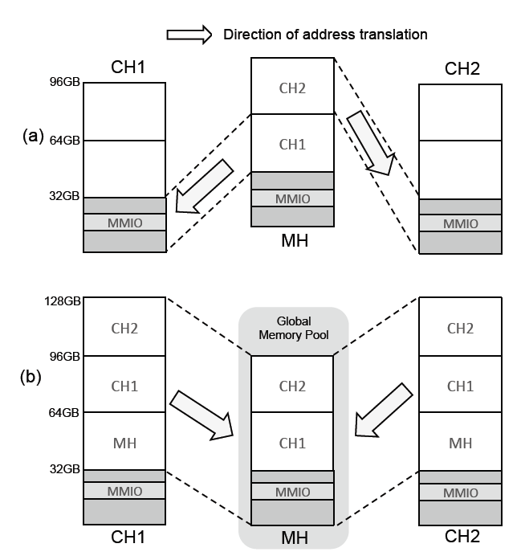
Construction of Global Address Space
Example:
MH writes to 32GB
  CH1’s address 0, usually in DRAM.
MH writes to 64GB
  goes to CH2’s address 0
CH1 writes to 96GB
  MH writes to 64GB
  CH2’s address 0
Any memory address of any host in the rack is accessible
Notes:
To support the three communication primitives,
We first need to construct a global memory pool or global memory address space, by allowing all hosts memory address space to be accessible from all other hosts
The construction requires two address translations;
one set up by the MH to map the physical memory of every attached machine to the MH’s physical memory address space, as shown in (a), and the other done by each attached machine to map the MH’s physical memory address space into its own local physical address space, as shown in (b).

